Slide 1
L4GA 2019 Cohort Two Grant Awareness Session
Julie Morrill- L4GA Program Manager
Georgia Department of Education
jmorrill@doe.k12.ga.us
706.473.3159
404.425.2975
Notes:
Make introductions

Slide 2
Literacy for Learning, Living and Leading in GA 2021
The Comprehensive Literacy State Development (CLSD) program is authorized under Sections 2222-2225 of the ESEA. The purpose of the CLSD discretionary grants is to create a comprehensive literacy program to advance literacy skills, including pre- literacy skills, reading, and writing, for children from birth through grade 12, with an emphasis on disadvantaged children, including children living in poverty, English learners, and children with disabilities
Notes:
Insert the whole child slide.

Slide 3
Title 1, Part E Elementary and Secondary Education Act of 1965
L4GA 2019 is subject to the “supplement-not-supplant” provisions as in other Title 1 programs.
Notes:
This is new for SRCL. I will be receiving guidance from USED on December 1. After that, I will be recording a brief conversation regarding the interpretation that you can share with your Title 1 colleagues.

Slide 4
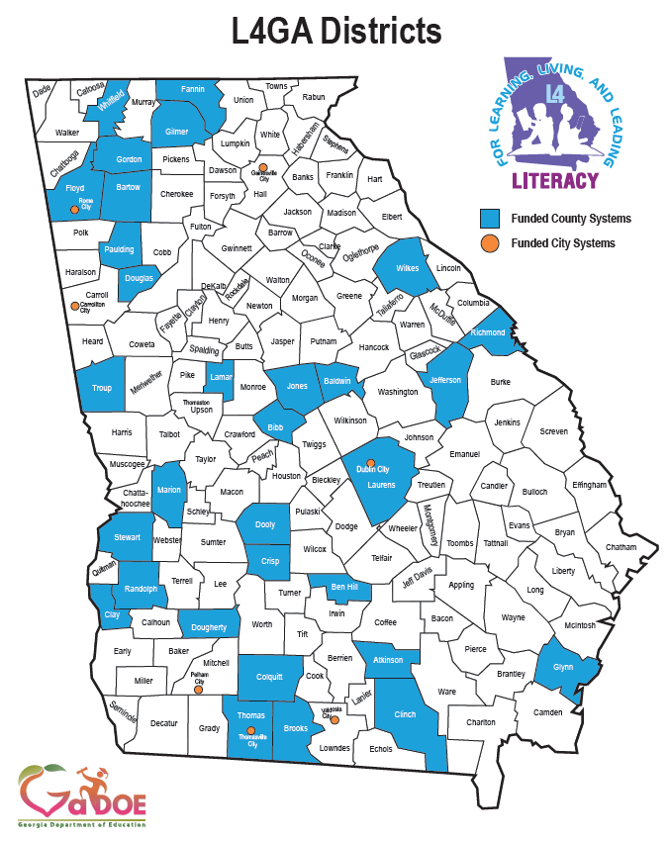
Notes:
Underlined denotes a repeat grantee.

Slide 5
Georgia L4GA Grant
Georgia’s state plan offers a unique approach to improving literacy by ensuring a well-rounded “whole child” education through choice in courses, activities, and programming enhanced through community partnerships with the purpose of providing students an enriched education experience

Slide 6
Georgia L4GA Grant
Georgia’s state plan also relies on involvement of the Governor’s Literacy Commission, with representation from all child-serving state agencies to ensure seamless services and coordinated budgeting.

Slide 7
Georgia L4GA Grant
The goal of Georgia’s plan seeks to improve literacy outcomes across all age ranges within feeder systems (early childhood, elementary, middle, and high schools) by 3% annually.

Slide 8
“Whole Child Education” Defined
Nourishes mental and physical health
Supports social and emotional well-being
Integrates arts, technology, and academics
Sparks creativity
Improves communication
Supports empowerment
Achieves each student’s potential
Creates passion for learning
Develops informed, adaptive, active citizens
Ensures digital access
Notes:
Education of the Whole Child begins at birth and continues through early adulthood, cultivating a respect and passion for the process of learning that will serve individuals throughout his/her life. Educators, in and out of school, can apply knowledge of child development to ensure supportive transitions throughout a child’s educational experience. This experience involves the family, school, and community. Relationships are key--they can provide a consistent social support system that will nurture a child from birth through adulthood. A child’s experiences in and out of schools should support learning and engage children as active participants and informed citizens in communities. Students’ physical health and nutrition, sense of safety and belonging, emotional and social well-being and mental health are essential to educating the whole child. The integration of arts, technology and core subjects can provide well-rounded, interdisciplinary experiences that challenge students’ intellect, spark their creativity, improve communication skills, make academic connections, and support the acquisition of skills that will prepare them to compete in the future workforce . Well-prepared, effective, and engaged teachers are essential to facilitating learning, from foundational numeracy and literacy skills to rigorous, advanced concepts. Empowering students to achieve their potential involves encouraging student voice, ensuring engagement (both academic and extracurricular), providing flexible, personalized learning experiences that develop a child’s interests and passions. Ultimately, students should emerge into adulthood with soft skills such as the ability to collaborate and work with others to problem solve, to respectfully communicate with peers and others who are diverse and may have differing cultural and global experiences, to prepare for future relationships and adult experiences, to knowledgeably choose and plan for careers, to be informed citizens, to understand personal finance, and to constructively adapt to technological innovations, and to become active and informed citizens.

Slide 9
L4GA 2019 Cohort Two Tentative Timeline
January 20, 2021
Grant application available on GADOE website
February 19, 2021
Survey Monkey Apply Webinar training (recorded)
February 19, 2021
Survey Monkey Apply Website Launch
March 1, 2021
Applications uploaded in Survey Monkey Apply by 5PM
March 2-4, 2021
Review of application components
April 2021
Federal compliance review and analysis of applications
May 12, 2021
Recommended sub-grantees submitted to State Board of Education for action
May 13, 2021
L4GA 2019 Cohort 2 Grant Awards announced
Summer 2021
L4GA 2019 Cohort 2 District, School and Community Kick-off
March 5-29, 2021
Reader review and scoring
January 22, 2021
Initial Virtual Grant Awareness Webinar
(recorded)
January 29, 2021
Email Intent to Apply from district lead Jmorrill@doe.k12.ga.us

Slide 10
L4GA 2019 project outcomes include:
student foundational literacy learning as well as content and disciplinary literacy;
professional capacity among teachers (pre-service and in-service) and other school staff;
instructional quality (preschool to grade 12);
community participation with literacy-related activities;
school climate;
systemic policies at the state level.

Slide 11
L4GA 2019 Award
95% of the funding will be sub-granted to LEAs. Small districts are encouraged to create collaborative networks with neighboring districts to leverage funding and grant capacity.
5% remains at the State for program administration, professional learning contracts, and evaluation.

Slide 12
Earmarked Funding
15% of funding “early learning” birth to age 5 (community partnerships )
40% of funding kindergarten through grade five (elementary school)
20% middle
20% high schools
Notes:
This is the formula you must use when thinking about building your projects.

Slide 13
L4GA 2019 Sub-grant Awards
Award amounts will vary in accordance with the congressional earmarks, subject to the number of children who will participate in the project, the quality of the application and the established need for the grant funding.
Notes:
This is the formula you must use when thinking about building your projects.

Slide 14
LEAs may choose to use 5% of total funding for grant administration.
Districts may use funding to hire literacy coaches while adhering to supplement/supplant guidance. L4GA hires must work directly with teachers.
Notes:
All funding must be used to build sustainable programs.

Slide 15
Grant Period
A grant award is made available for an approved performance period of four years.
Award money must be distributed across multiple years of the life of the grant
Sub grantees for L4GA 2019 will have until September 30, 2024 to draw down, or actually spend their grants.
LEA’s will then have a 30-day time period for liquidation and to submit completion reports.

Slide 16
Applicants must apply in a feeder pattern.
Each LEA-Partnership must include a feeder system that includes at least one early education center (e.g., Headstart, Early Headstart, Quality Rated (QR) child care (or a QR applicant), and/or Georgia’s PreK), a community partner organization, and schools serving students from Kindergarten through grade 12.
Notes:
This is the formula you must use when thinking about building your projects.

Slide 17
Applicants must have at least one school with a climate rating of a 4 or 5, and/or be implementing PBIS.
Notes:
This is the formula you must use when thinking about building your projects.

Slide 18
Each LEA-Partnership must already be involved as a Get Georgia Reading Campaign community or applying to become one. http://getgeorgiareading.org
Notes:
This is the formula you must use when thinking about building your projects.

Slide 19
Each LEA-Partnership must include a P-20 partner from a Georgia Institution of Higher Education
Notes:
This is the formula you must use when thinking about building your projects.

Slide 20
Each LEA-Partnership must include a liaison from the Regional Education Service Agency (RESA) that serves the LEA.
Notes:
This is the formula you must use when thinking about building your projects.

Slide 21
Students Birth to Grade 12
Will have access to high-quality materials in both print and digital form, fiction and non-fiction, that support the Georgia Standards of Excellence in all content areas.
Will receive an evidence-based curriculum, consistent with the science of reading, that will ensure adequate delivery of the Georgia Standards of Excellence.
Will receive an evidence-proven literacy block that includes all elements of a comprehensive literacy program (e.g., dialogic reading, peer-assisted learning, small group reading interventions, developing academic English, explicit comprehension strategy instruction, explicit vocabulary instruction) using a variety of engaging, high-quality texts.
Will receive evidence-based instruction in Literacy (Reading, Writing, Listening, Speaking, Viewing) within content area courses using evidence-based delivery models as well as robust, engaging text.

Slide 22
Teachers of literacy birth through grade 12
Will engage learners by establishing a positive learning climate and using instructional approaches that are responsive to the community (e.g., linguistically, culturally, developmentally appropriate).
Will implement ongoing formative and summative assessments and use data to inform instructional decisions and to evaluate the effectiveness of instruction.
Will engage in high-quality professional learning to build their competence in evidence-based practices in literacy instruction, delivery of content, and peer support.

Slide 23
School Leadership Teams
Will engage in high-quality professional learning to build their competence in evidence-based practices for literacy instruction and evaluation of instructional performance.
Will demonstrate commitment to literacy by convening partners (teachers, community organizations, families, students) to focus on literacy-related services and activities.

Slide 24
School and District Leaders
Will use local and state data to create literacy plans for feeder patterns; focusing on growing potential for the local community to meet the needs of children from birth through grade 12.
Will ensure that grants funded to L4GA 2019 partnerships are supported through proper and timely allocations and resources.
Will ensure that the district goals align – and do not conflict – with those of the funded schools.
Will facilitate partnerships with community organizations to provide social services for families and children attending local schools.

Slide 25
Teacher Educators/ Literacy Researchers
Will partner with B-12 teachers and leaders to lead professional learning about evidence-based practices for literacy instruction.
Will engage in a networked improvement community called the “Literacy Think Tank” to improve their own competence in evidence-based practices in literacy instruction.
Will engage with local community partners to support literacy-related activities and communications for families, youth, and children.

Slide 26
Community Members
Will provide support services for children, youth and families as determined by the local needs defined by the partnership.
Will demonstrate commitment to literacy by providing and supporting literacy-related activities and communications for families, youth, and children.

Slide 27
Georgia Department of Education
Will align SEA initiatives and requirements as much as possible and support sub-grantees by provide guidance about alignments.
Will deliver a communications system provides real-time access updated online and face to face training as well as assessment windows and new resources both internal and developed by outside partners.
Will provide state data to support local efforts.
Will convene and facilitate teacher educators and literacy researchers to improve the network’s capacity and competence.
Will facilitate a comprehensive approach to professional learning that promotes evidence-based practices and involves alignments face-to-face statewide convenings, online learning, and on-site interactions among sub-grantee partnerships via professional learning communities and coaching.

Slide 28
Evidenced-Based Practices
L4GA 2019 partnerships that apply for subgrants will describe how their plans align to the following:
Research-based
Data-informed
Responsive to the Community
Professionalizes educators

Slide 29
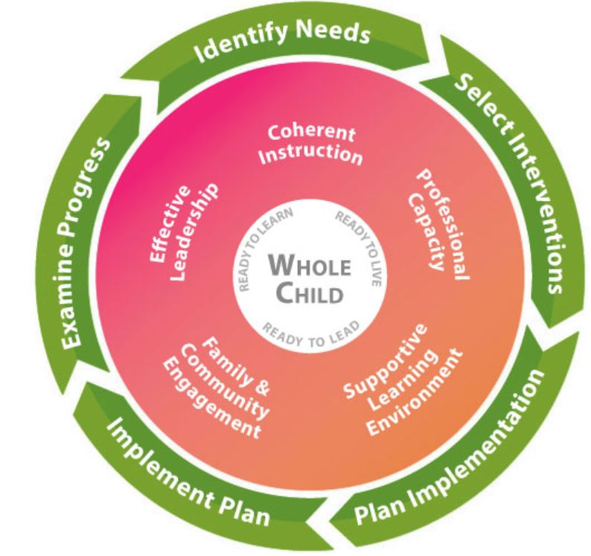
Continuous Improvement Approach to Outcome Evaluation
(a) documenting positive practices and
(b) gauging the overall the impact of the L4GA 2019 project.

Slide 30
Continuous Improvement Approach to Outcome Evaluation
Two evaluation teams:
Dr. Gary Bingham and
Dr. Rihana Mason
Georgia State University
Dr. Lizanne DeStefano and
Dr. Meltem Alemdar
Georgia Institute of Technology

Slide 31
Assessments for B-5
PALS (3x/yr) (Illuminate ED)
PPVT 4 (2x/yr) (Pearson)
Work Sampling Online (BFTS)
GKids/ Readiness Check & Gkids Performance-Based Assessment
Notes:
Add in our evaluators as well as the assessment plan

Slide 32
Assessments for K-5
DIBELS-Next (Acadience) (3x/yr)
Screener/Progress Monitoring
K = Composite
1st = Nonsense Word, Oral Reading Fluency
2nd - 3rd = Oral Reading Fluency
Houghton Mifflin Harcourt Reading Inventory (RI) (3x/yr)
Screener 3rd – 11th
Comprehension

Slide 33
Assessments for 6-11
Houghton Mifflin Harcourt Reading Inventory (RI) (3x/yr)
Screener 3rd – 11th
Comprehension

Slide 34
We will report milestones data as our outcome for 3rd, 5th, 8th, high school
The evaluation teams and research-evaluation specialists will work directly with funded districts
Notes:
All funding must be used to build sustainable programs.

Slide 35
District Literacy Team
District Literacy Teams
What community partner?
2
Does it include special area teachers?
3
How does it function?
4
How often does it meet?
5
Does its work in conjunction with school teams?
Who serves on the district literacy team?
1
Notes:
This team needs to transition to a partnership with community stakeholders.

Slide 36
Literacy Plan Design and Use of L4GA 2019 Funds
Provide
Provide a tiered system of support, ensure that staff is properly trained, and confirm that students are appropriately placed (Pre-K, elementary, middle and high school)
Provide
Provide for at least 90 minutes of direct literacy instruction and incorporate literacy strategies throughout the content areas
Provide
Provide for at least 2-4 hours of literacy instruction embedded into the content area
Ensure
Ensure that all leaders are active participants in all training, as well as assessments and project management

Slide 37
Literacy Plan Design and Use of L4GA 2019 Funds
Reimburse all travel expenses for staff to attend professional learning and meetings
01
Intervention materials, assessment materials and training for teachers in all content areas including special education, CTAE and ESL
02
Classroom equipment, materials, and supplies related to literacy, content literacy and literacy instruction
03
Provide funding for the activities of the community coalition that supports birth to age five. This includes: local libraries, partnerships to increase access to print, Get Georgia Reading events.
04

Slide 38
Monitoring
Each site will be initially visited by the Project Director to establish program norms, provide technical assistance and to meet the team.
An annual performance evaluation will be conducted by the Project Director
Technical Assistance by program staff will be provided as needed either in-person or virtually.
Notes:
update

Slide 39
Sustainability
Must consider sustainability of processes, programs, and equipment beyond the life of the grant

Slide 40
To prepare for the upcoming sub-grant competition
Subgrant Development
Submit
Submit Intent to Apply Spreadsheet downloaded from the website. Email to Julie Morrill @jmorrill@doe.k12.ga.us
Convene system and school literacy teams
Decide who are appropriate members of literacy team prior to formulating grant proposal
Conduct
By using your Comprehensive Needs Assessment, literacy needs assessments, and other pertinent data, conduct a thorough review of all schools to establish a feeder pattern that has capacity and would benefit from this type of literacy reform effort
Design
Once root cause has been established, convene the stakeholder and begin designing a solid program that will ensure sustainable success for all students.

Slide 41
LEA-Partnership Narrative
Identification of feeder system(s) and community served
Identification of all LEA-Partnership partners
Data visualization work to support needs assessment
A brief description of the feeder system(s) identified, and history of the L4GA 2019 LEA-Partnership
Population demographics of the community
Climate Ratings for each school involved in the proposed partnership and/or status of implementation of PBIS
Student literacy/ELA outcomes of the feeder system
Plan for engaging
Early childhood education providers
P-20 research-practitioner partnership(s) and literacy faculty in the local teacher preparation programs
Community coalition

Slide 42
Established Need
Established need for a L4GA 2019 Project based on GaDOE analysis of third-grade reading growth for students who are economically disadvantaged, students with disabilities, and English learners

Slide 43
Needs Assessment and Root Cause Analysis
Outcomes of analyses conducted with Georgia’s System for Continuous Improvement: Coherent Instructional System
Past instructional initiatives
Current instructional initiatives
Community and Family Engagement
Engaged Leadership
Positive Learning Environment
Professional Capacity
Other Supports for the Whole Child

Slide 44
School Literacy Plans
Leadership team
School literacy needs assessments and plans

Slide 45
Professional Learning Plans
Plan for engaging LEA-Partners with L4GA 2019 Professional Learning offerings: Institutes, Online PL supports, and Local PL supports (e.g., PLCs, collaborative planning, coaching, mentoring)
Time allocated for collaborative planning time per grade level team and vertical teams. NOTE: LEA-Partners must agree to utilize their L4GA 2019 professional learning plan as their singular plan for literacy-related professional learning to avoid layering conflicting professional learning opportunities that could be available in a large LEA.
Topics of interest for PL for each audience (e.g., early learning; secondary education; community/family liaisons; etc.)
Topics that the LEA-Partnership could provide to the L4GA 2019 PL catalog due to particular LEA-Partners’ expertise or experiences with positive outcomes. (Involve the P-20 and RESA partners and outstanding teacher leaders when determining what the LEA-Partnership can offer to the L4GA 2019 program)

Slide 46
Compliance with FERPA, GPRA, GADOE rules and state and federal laws
Assurances and Memo of Understanding

Slide 47
LEA-Partnership Management Plan and Key Personnel
LEA office support for grant management.
Who are the key people involved in the grant?
How will the grant function in terms of the whole district strategic plan and comprehensive needs assessment?
How will financial aspects of the grant be handled?
Will there be a dedicated staff member at the district office with the responsibility of grants administration?
Ability of the LEA to adequately administer the funding.
Any financial audit findings over the past three years should be discussed in this section.
Controls for spending should be pointed out.

Slide 48
Project Goals, Objectives, Activities, Outputs, Outcomes, and Supports needed
Implementation plan proposed for funding.
The plan should show how the instructional strategies, delivery models and programs are consistent with EBP and directly address the needs of the students and educators.

Slide 49
Assessment/Data Analysis Plan
Assurance that assessment and evaluation requirements for the SEA will be completed.
Estimated cost for assessments included in proposed LEA-Partnership budget
Detailed assessment protocols are specifically detailed including: who, what, and when the assessments will be given as well as analyzed.
Procedures for educators’ analysis of local assessment data to inform instruction

Slide 50
Resources, Strategies and Materials including Technology to Support Implementation of the Literacy Plan
Instructional resources that will be used or purchased as a result of L4GA 2019 funding. Services that will be purchased as a result of the L4GA 2019 funding.
All expenditures should all tie back to community and student data, the comprehensive needs assessment, and root cause analysis.
All expenditures should directly impact literacy, access to print, student engagement, and teacher support. They should be consistent with EBP.
This is not a technology grant; only technology supports vital to literacy improvement and instruction should be allocated.

Slide 51
Budget

Slide 52
Scoring and Competitive Priority
Poverty Index
Percentage of students reading below grade level
Rate of growth of the number of students reading at or above grade level over the past three years
Additional factor - the number of schools implementing comprehensive and targeted improvement activities in a district

Slide 53
Rural Competitive Preference
If the LEA is rural, then competitive preference points are awarded. At least one of the following criteria must be met for an LEA to be considered “rural”:
Has fewer than 600 pupils in average daily attendance at all of the schools
All of the schools have a school locale code of 41, 42, or 43 as designated by the US Secretary of Education
Each county served by the LEA has a total population density of fewer than 10 people per square mile

Slide 54
Survey Monkey Apply
Survey Monkey Apply is an online data management system that allows us to do all of our grant development and management in one location.
It allows us to set up work-flow so that you will upload and manage your grant development and then we will manage the review.
Survey Monkey Apply will be live in February 19, 2021

Slide 55
Suggestions
School developed applications gleaned higher scores
Frequent request for technical assistance
Administrative support
School and system buy-in

Slide 56
Resources to get started on the literacy plan
Literacy for Learning, Living and Leading in Georgia (L4GA 2019) State Literacy Plan
GaDOE-provided pre-populated data from the Comprehensive Needs Assessment (CNA) for Federal Programs using the framework of Georgia’s System for Continuous Improvement
GaDOE-provided pre-populated data from the Comprehensive Needs Assessment (CNA) for Federal Programs using the framework of Georgia’s System for Continuous Improvement
Georgia’s System for Continuous Improvement with links to Evidence-based IES-REL Practice Guides
Georgia’s Literacy Needs Assessment Templates B-5 and K-12 (these are adapted to align the IES/REL Needs Assessments to Georgia’s System for Continuous Improvement
Georgia’s Literacy Needs Assessment Templates B-5 and K-12 (these are adapted to align the IES/REL Needs Assessments to Georgia’s System for Continuous Improvement
Revised “Why, Who, What, and How” document to implement an evidenced-based literacy curriculum
GaDOE’s Learning Object Repository which populates the Teacher Resource Link
https://www.edreports.org/resources/article/the-power-of-engaging-all-educators-during-an-instructional-materials-adoption?utm_medium=email&utm_source=pardot&utm_campaign=rundown-nov-2019

Slide 57
Professional Resources and Data
Get Georgia Reading Find Data- http://getgeorgiareading.org/data/find-data/
Rollins Center for Language and Literacy- Cox Campus https://www.readrightfromthestart.org/
Georgia Insights http://www.gadoe.org/Georgia-Insights/Pages/default.aspx
Governor’s Office of Student Achievement https://gosa.georgia.gov/
Ferst Foundation http://www.ferstfoundation.org/
Imagination Library https://imaginationlibrary.com/

Slide 58
Community Outreach and Leadership
Reach out and Read Georgia http://www.reachoutandread.org/georgia/
Georgia Early Education Alliance for Ready Students https://geears.org/
Georgia Communities in Schools http://cisga.org/
Georgia Family Connections Partnership http://gafcp.org
Vision to Learn-Atlanta https://visiontolearn.org/where-we-work/georgia/
Georgia Public Library Service http://www.georgialibraries.org/

Slide 59
L4GA 2019 Listserv
Send a blank email to: join-l4ga@list.doe.k12.ga.us

Slide 60
Intent to Apply:
Please email the attachment to Julie Morrill
jmorrill@doe.k12.ga.us
Due date for email is January 30, 2021

Slide 61
For assistance please contact:
Julie Morrill – L4GA Project Director
jmorrill@doe.k12.ga.us
Office: 404-425-2975
Mobile: 706-473-3159
Phone or Text
Meghan Welch – L4GA Program Specialist
mwelch@doe.k12.ga.us
Office: 404-309-7413
Mobile: 404-219-3068
Phone or Text
ADD Lisa and Sian here???
http://www.gadoe.org/Curriculum-Instruction-and-Assessment/L4/Pages/Literacy-Grant.aspx

